Slide 1

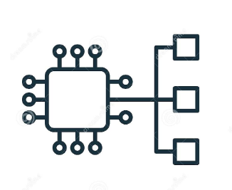
Amazon Eks cluster

Slide 2
Why Eks cluster?
Kubernetes is an open-source system for automating the deployment, scaling and management of containerized applications.
Eks provides a high available and fully managed Kubernetes control panel/service that makes it easy for you to run Kubernetes.
Images can be build and deploy the worker nodes to Amazon Eks cluster.

Slide 3
Eks topology
Master Node -: These are the control nodes which are deployed in AWS manged VPC and access through network interface.
Worker Node -: These are the data nodes deployed in Aws worker VPC and use to host workload.

Slide 4
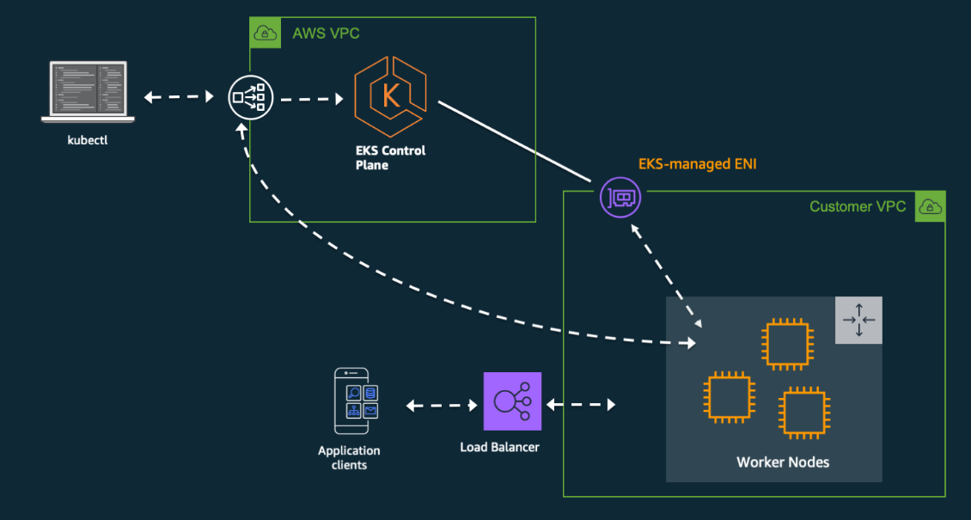
Eks diagram

Slide 5
Eks requirements
Define containerized application delivery process to Eks.
Create and scan the Docker image.
Attach storage or volume to container.
Define secrets within the containerized application.
Create IAM role for Eks.
Create workloads to support containerized solution.
Secure the pod network by assigning separate security groups.
Track the log and monitor the Eks cluster

Slide 6
Run Jenkins on Eks cluster

Slide 7
Build Requirements
AWS CLI
Docker engine
Aws-iam-authenticator
kubectl
eksctl
Configure your AWS credentials with the associated region.
Build image
Create an EKS Cluster using eksctl.
Verify that EKS nodes are running and available.
Create an AWS ECR Repository / Docker Repository for the Jenkins Manager and Jenkins Agent.

Slide 8
Eks requirements

